Slide 1
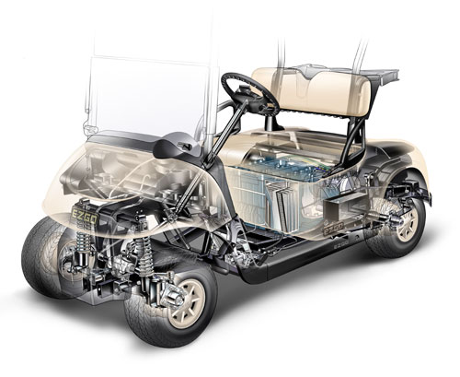
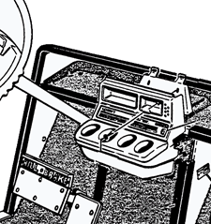
General Cart Diagram
Section 3A
Section 3
Section 2
Section 4
Section 2A
Section 1

Slide 2
1
3-Way Switch located
on dashboard (Section 2A)
Brake Encoder
Gas Encoder
Gas Micro Switch
2
Relay in Arduino Box
(Section 4)
3
Continues on Arduino
Wiring Diagram
L06
4
Continues on Ignition Relays
Wiring Diagram
L08
3-Way Switch
5
All elements are located in
Section 1 of the General Cart
Diagram unless otherwise
Noted.
L01A
L03
L07
L09
Note 4
Relay
L01
Note 3
Note 1
Note 2
Note 3
L02
Note 3
L04
L05
Note 3
Gas – Brake - Micro switch

Slide 3
Cart Ignition Plug
1
Switch located
on dashboard (Section 2A)
Horn
2
Not Used
A B C D
3
Continues on Gas – Brake
Diagram
L10
4
Continues on Arduino
Wiring Diagram
L19
Note 3
L11
L16
Note 4
L01A
L01A
5
All elements are located in
Section 2 of the General Cart
Diagram unless otherwise
Noted.
L12
L20
L21
Note 3
Relay
Note 4
L13
L17
Note 4
L14
L15
L18
Note 4
Ignition
Reverse
Forward
L34
Note 1
Emergency Stop (normally closed)
L35
Power
Ignition Relays

Slide 4
Motor
L23
1
On/Off Switch located
on dashboard (Section 2A)
L24
L25
L26
Note 4
Drive
Note 5
L27
2
To Golf Cart Battery
L22
3
Continues on Gas – Brake
Diagram
Note 6
Note 7
4
Continues on Arduino
Wiring Diagram
L30
5
J6 connection shown in
Drive Manual
L31
Note 4 & 7
L32
6
J7 connection shown in
Drive Manual
L33
L28
L29
7
J4 connection shown in
Drive Manual
8
All elements are located in
Section 3 of the General Cart
Diagram unless otherwise
Noted.
Note 1
Note 2
Motor – Drive Wiring

Slide 5
Arduino
(and Arduino container)
Gas – Brake Plug
1
On/Off Switch located
on dashboard (Section 2A)
L01
GND
2
To Golf Cart Battery
L02
Pin 12
L04
Pin 13
3
Continues on Gas – Brake
Diagram
L09
Pin 53
4
Continues on Ignition Relays
Wiring Diagram
Note 3
Ignition Plug
5
Continues on Motor Drive
Wiring Diagram
L16
Pin 50
L17
Pin 49
6
All elements are located in
Section 4 of the General Cart
Diagram unless otherwise
Noted.
L18
Pin 48
L21
Pin 51
Pin 42
Pin 52
Note 4
P37
P35
P33
P31
P21
P3
P2
GND
5V
Motor Encoder
Plug
Drive Plug
L23
L24
L25
L26
L27
Note 5
Note 5
L30
L31
L32
L33
Arduino Wiring

